Slide 1
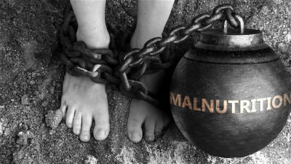
MALNUTRITION ACROSS THE GLOBE
REVIEW - 1
Notes:
Line spacing + Page numbers

Slide 2
Team Members
Name | Roll No
Tejashwini K T | 20211IST0010
Sathya R | 20211IST0012
Darshan RN | 20211IST0008

Slide 3
Agenda
01 Introduction
02 Results from last year
03 Tools Used
04 Implementation
05 Outcomes
06 Limitation and Scope
07 Conclusion

Slide 4
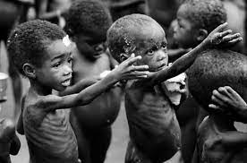
Introduction
01
The aim of this project is to analyze a comprehensive dataset on malnutrition indicators across countries and regions, identify key trends and patterns, and visualize the data to provide insights for policymakers, researchers, and organizations working to combat malnutrition.
The analysis will focus on understanding the prevalence of malnutrition, its distribution, contributing factors, and the effectiveness of interventions, with the goal of informing targeted strategies to reduce malnutrition and improve nutrition outcomes worldwide.

Slide 5
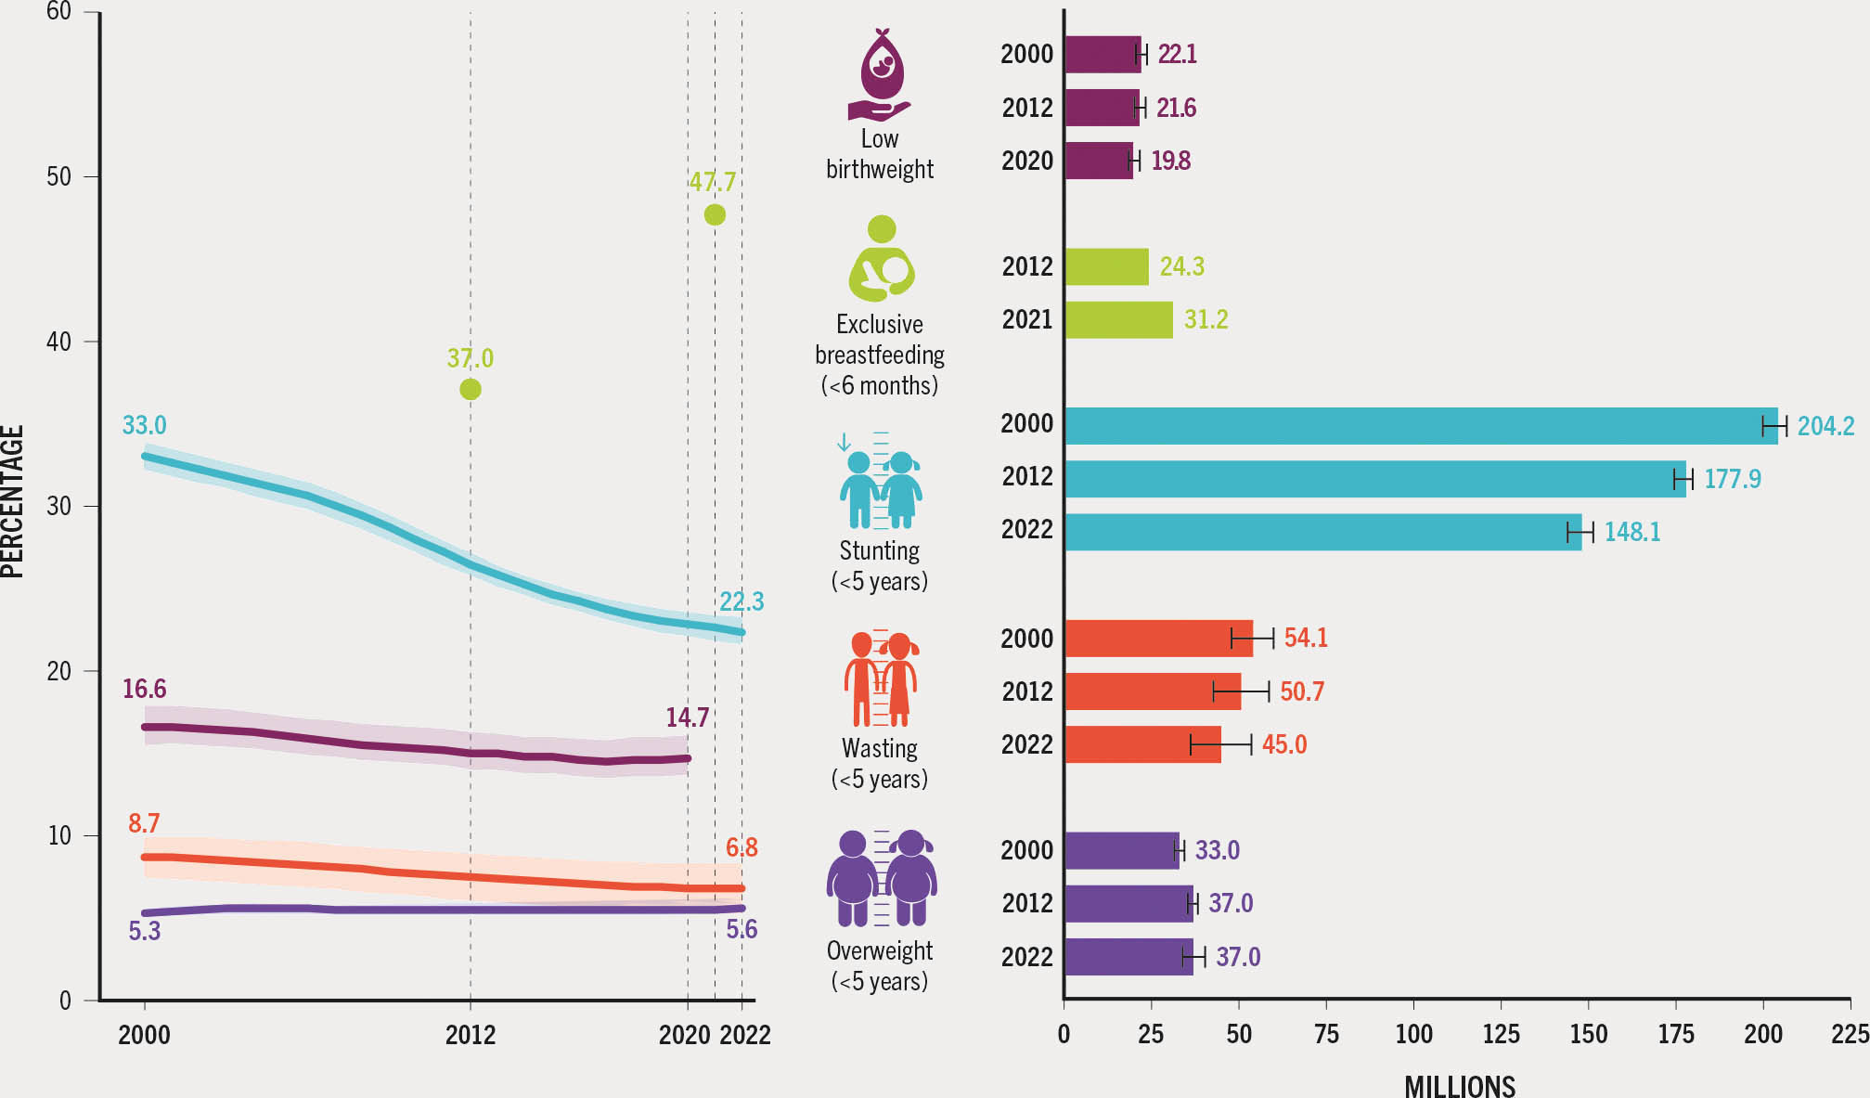
Growth by sector

Slide 6
Tools Used
Software:
Google Colab: Colaboratory allows us to write and execute Python codes in our browser.
Libraries:
NumPy
Pandas
3. Seaborn
4. Matplotlib
5. Suppress Warnings
Database: Malnutrition across the Globe

Slide 7
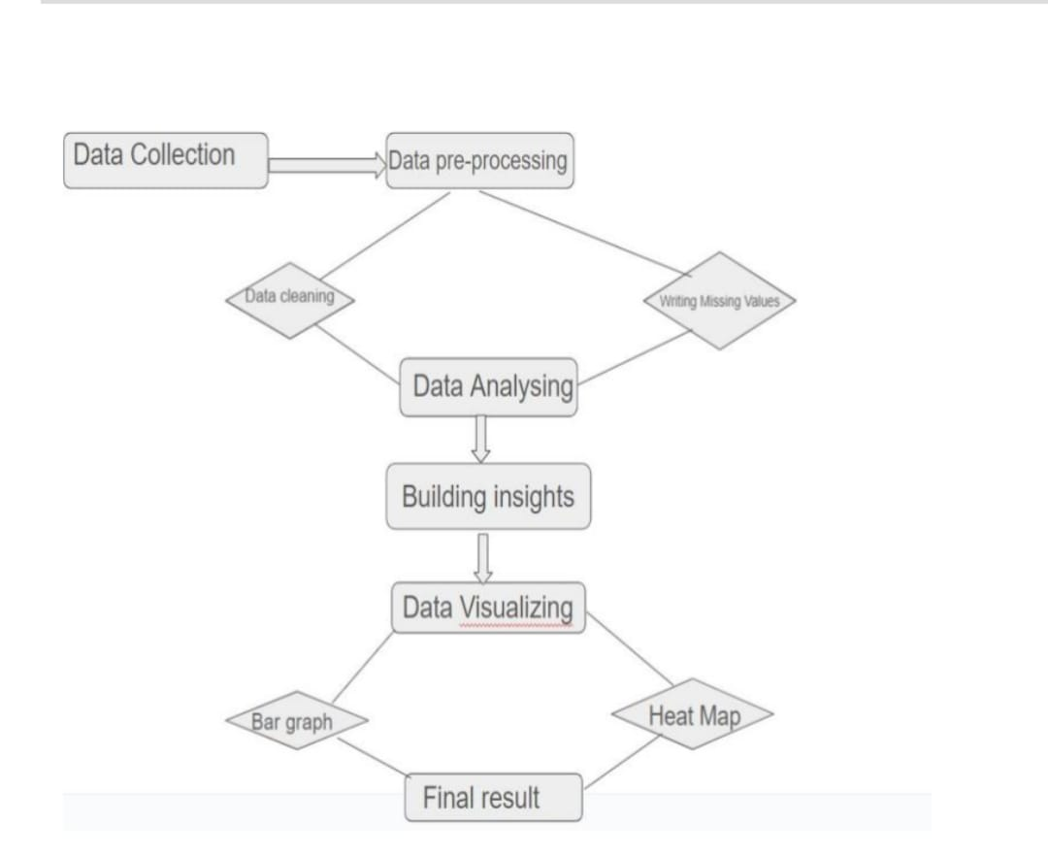
METHODOLOGY

Slide 8

IMPLEMENTATION

Slide 9
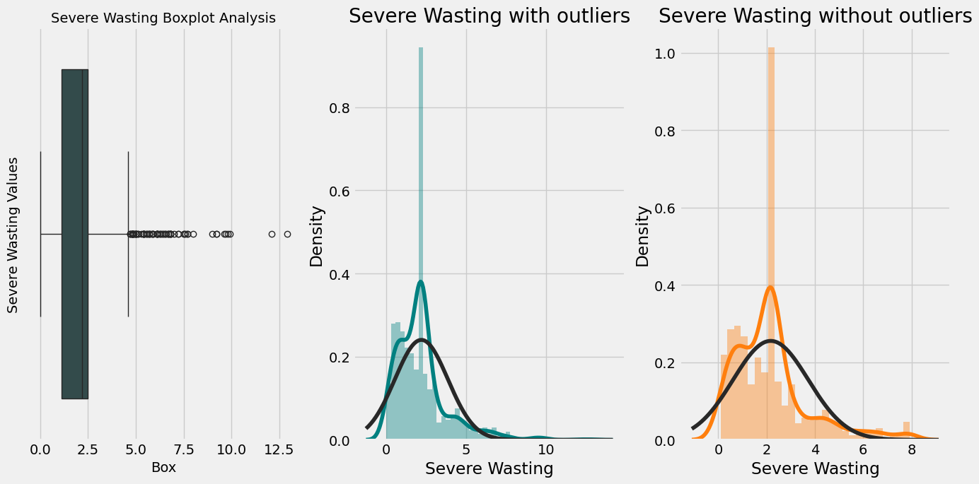

Slide 10
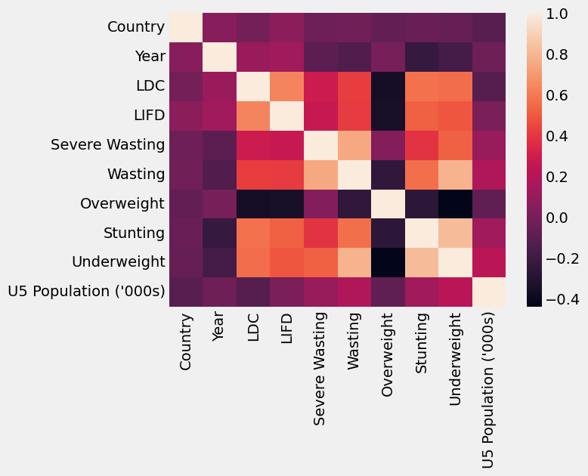
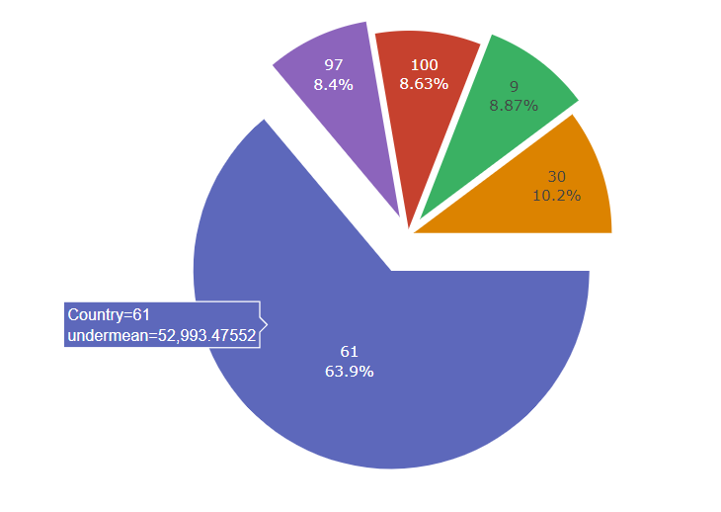

Slide 11
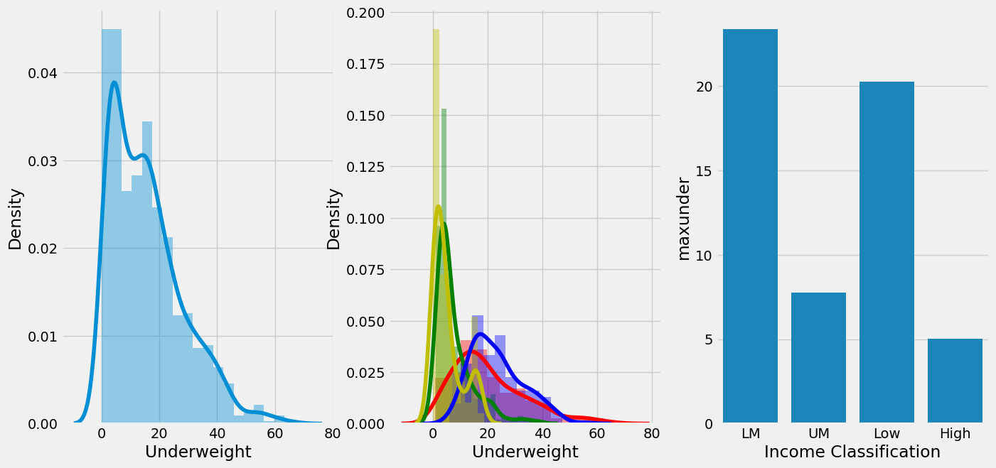
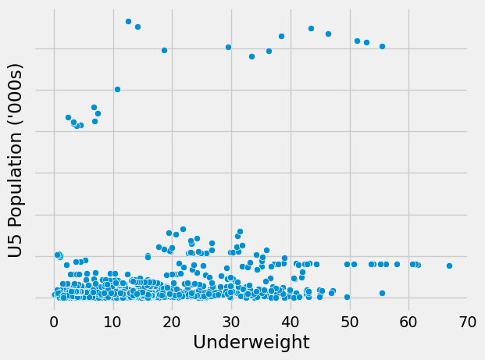

Slide 12
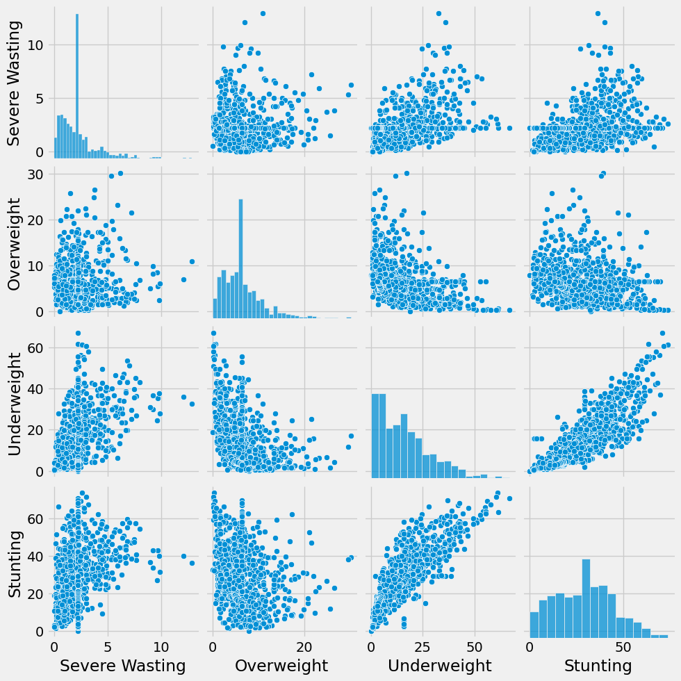
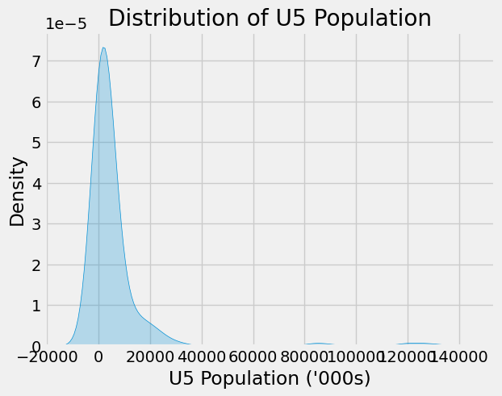

Slide 13
LIMITATIONS AND FUTURE SCOPE
Data Quality and Availability
Granularity
Complexity of Malnutrition
Visualization Challenges
Technical Constraints
Predictive Analytics and Forecasting
Policy and Decision Making
Integration with Other Data Sources
Technological Advancements
Mobile and Remote Access

Slide 14
CONCLUSION
Visualizing malnutrition data globally reveals critical insights into the disparities and trends affecting various regions. By employing data visualization techniques, we can identify patterns of malnutrition, highlighting areas with severe food insecurity and undernutrition. These visual tools aid policymakers, researchers, and humanitarian organizations in targeting interventions more effectively. Ultimately, these visualizations not only illuminate the scope of the problem but also drive informed decisions to combat malnutrition, promoting global health and well-being.

Slide 15

THANK YOU

